Slide 1

Eternity Calculator for sinh(x) Support
prepared by:-
Abideep Singh Kondal
40241215
<<D1 deliverable>>

Slide 2
About the project
This project implements the scientific transcendental function sinh⁡(x)\sinh(x)sinh(x) using first-principles Java programming. The function is embedded within a console-based calculator called Eternity Calculator (for sinh(x) Support).
The implementation follows ISO/IEC/IEEE 29148 standards for requirements and includes a contextual model, testable logic, and an extensible structure.
The system is designed for iterative development, with future enhancements (GUI, testing frameworks, accessibility) planned in D2 and D3.

Slide 3
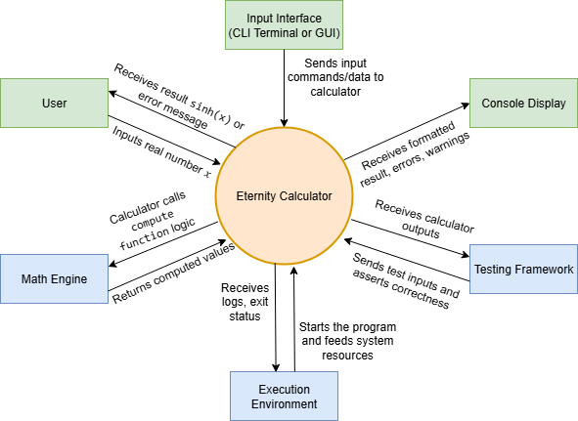
Context of Use Model
Users include students, researchers, and engineers solving scientific problems.
Inputs are given via a CLI (keyboard), and outputs are shown on a console.
Math.exp() is used for calculation using Java’s Math Engine.
Testing and debugging are supported in a standalone Java runtime.
The context ensures the program is portable, testable, and suitable for demos and scripting.

Slide 4
Requirements – Functional
Assumptions:
A1 - | Input is a real number from the keyboard.
A2 - | Output is rounded to 6 decimal places.
A3 - | Input range is limited to [−100,100] to avoid overflow.
A4 - | Uses Java Math.exp() for computing exponential.

Slide 5
Requirements – Functional
REQ-1 | The calculator shall accept a real number input x via the keyboard.
REQ-2 | The calculator shall compute sinh(x) using the formula (e^{x}−e^{−x})/2.
REQ-3 | The calculator shall round and display the result of sinh(x) to 6 decimal places.
REQ-4 | The calculator shall restrict input values to the range [−100,100] and display an appropriate warning if out of bounds.
REQ-5 | The calculator shall support repeated computations until the user chooses to exit

Slide 6
Requirements – Non-Functional
REQ-6 | The calculator shall return the result within 100 milliseconds for valid inputs in the allowed range.
REQ-7 | The system shall run on any platform that supports Java SE 8 or higher.
REQ-8 | The system shall handle malformed input (e.g., non-numeric input) gracefully and prompt the user to retry.
REQ-9 | The implementation shall support unit testing using standard Java test frameworks (e.g., JUnit).

Slide 7
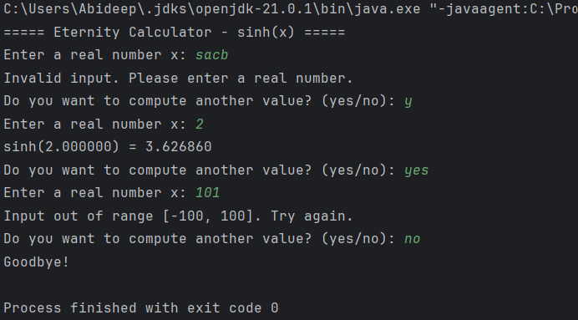
Java Implementation Overview
Developed in Java using standard I/O and Math.exp().
Console-based interaction, no dependencies.
Loop continues until user exits with “no”.
Input validation included for range and type.
Link to repository : https://github.com/DeepKondal/Eternity

Slide 8
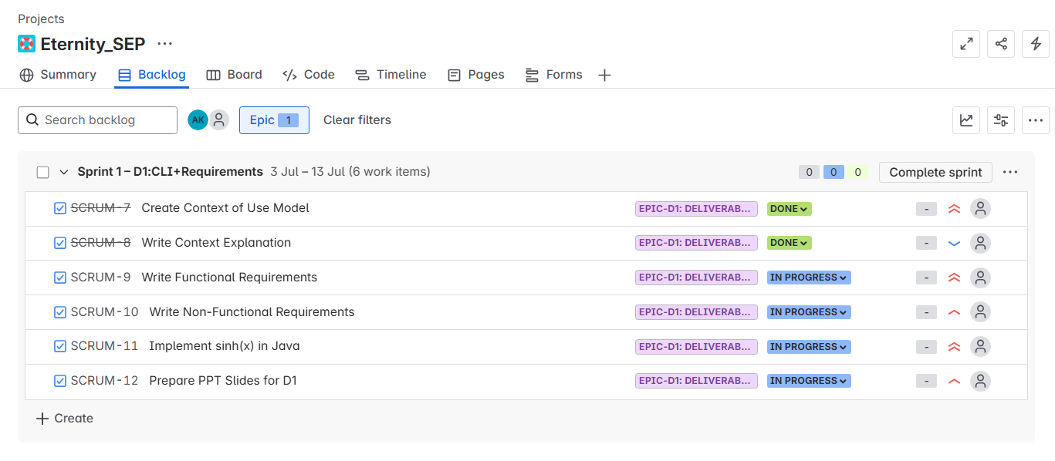
Agile Planning with Jira
The Eternity Calculator project is managed using Jira to align with the agile and DevOps-inspired structure of the course.
Tasks for Deliverable 1 are grouped under Epic-D1 and are individually tracked with progress status.

Slide 9
Conclusion and What’s Next
What's Completed?:
Context of use model
ISO-standard requirements
Java implementation (CLI)
Upcoming in D2/D3:
Full GUI with Swing/JavaFX
Custom implementation without using any external Libraries
Exception handling, testing tools, static analysis
Accessibility and styling validation

Slide 10
Thank you
Any questions?

